Slide 2


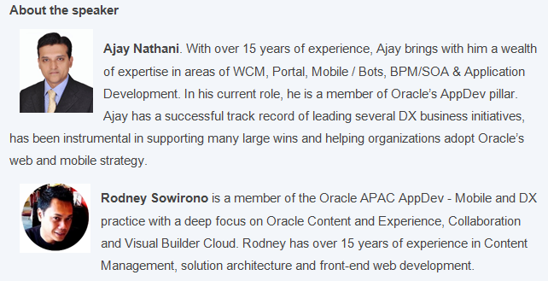
The Age of Autonomous AppDev -
Building Web & Mobile App without Coding

Slide 3
Visual Builder Cloud in Action
Café Supremo is a fictional Coffee company and coffeehouse chain, with store locations worldwide.
Provide Human Resources Web and Mobile Application for Café Supremo employees
Centralize Timesheet Reporting, Expense Submissions, Travel Approval, Leave requests
Dashboard for Managers
GOALS
Developer to easily create Web and Mobile applications using Low-code, declarative development tool
Reuse of UI Components, Business Objects and Service Providers
Developer enablement through integrated platform to manage code
SOLUTION

Slide 4
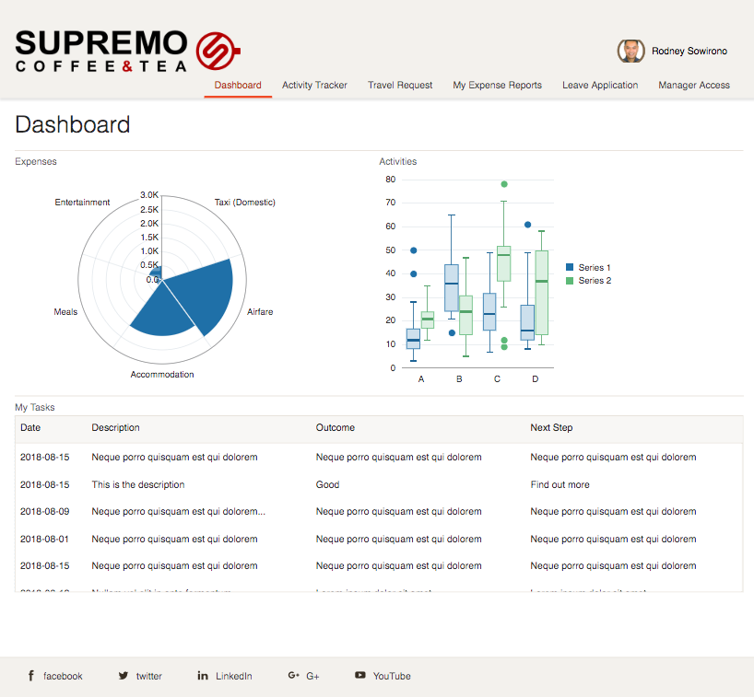
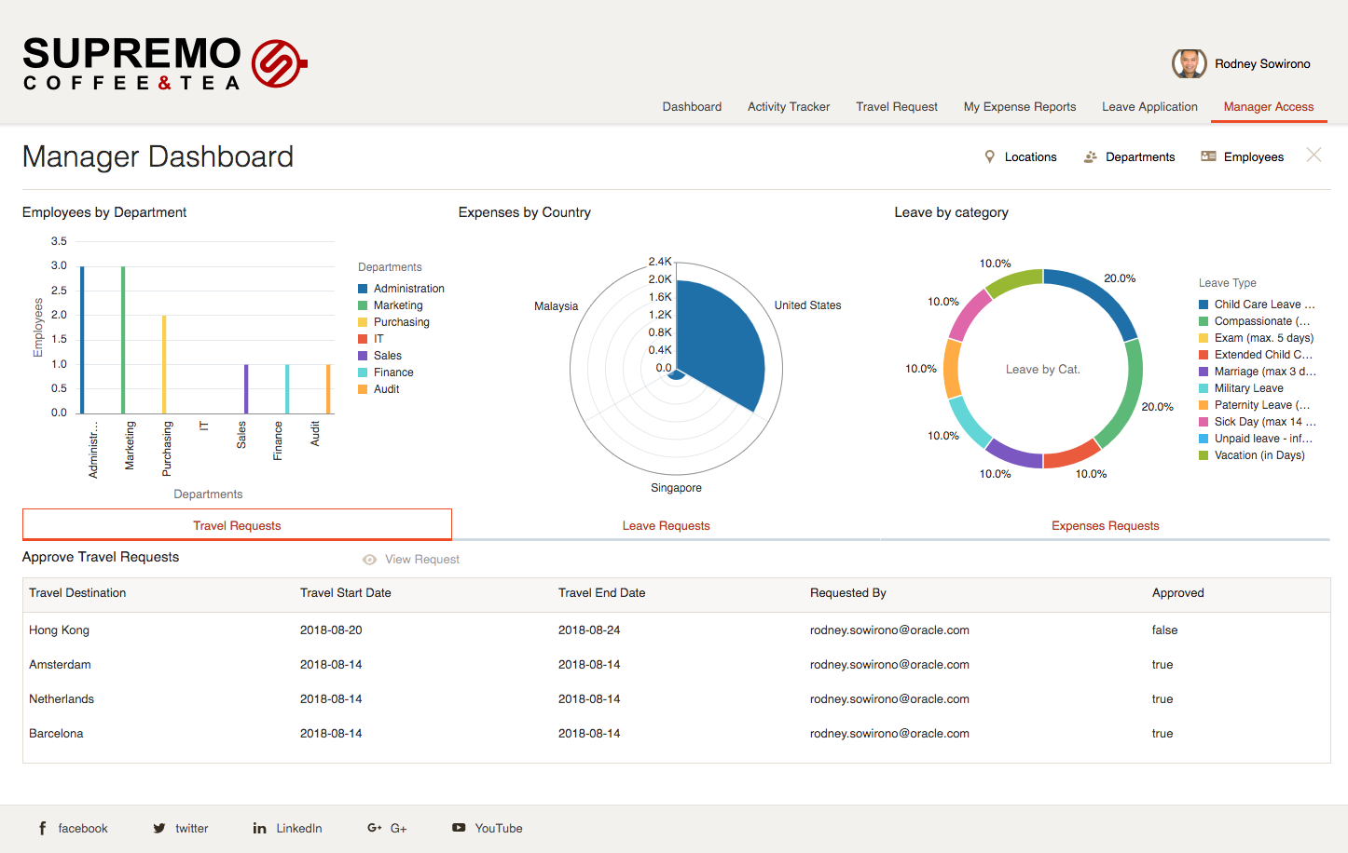
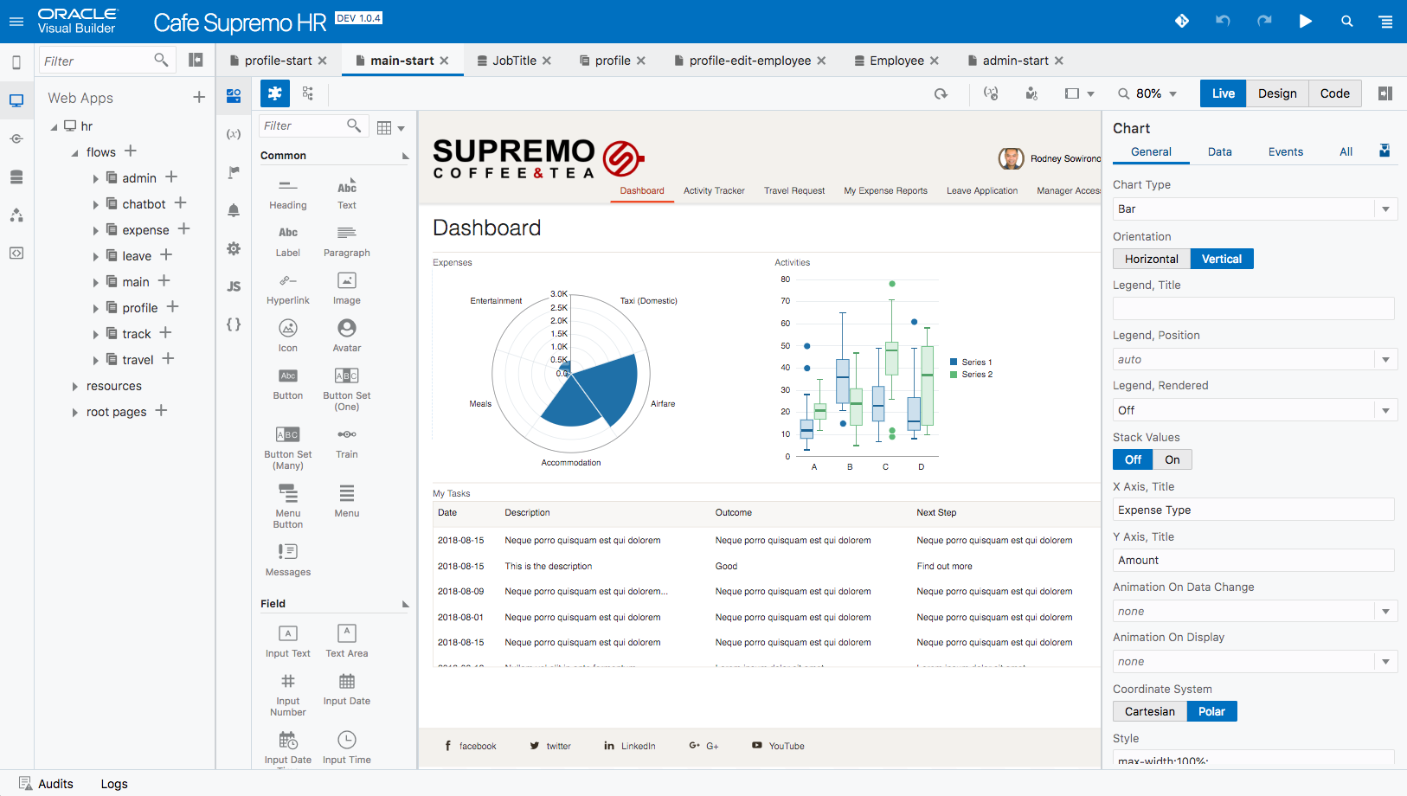

Café Supremo Demo Personas
KIRK
ROBIN
SANDY
Barista
Manager
Developer
Works in a Café Supremo coffee shop
Manages store personnel and approvals
Developed the Café Supremo web and mobile HR App
Staff
HQ

Slide 5
Consumer: Employee Persona - Kirk
Kirk:
Checks into employee HR site and engages with site content for the Travel, Expenses, Leave and Timesheets
Visual Builder Cloud:
Engages employees directly with interactive apps and content
Responds to employee actions and provides personalized experience
KIRK
Barista
Works in a Café Supremo coffee shop

Slide 6
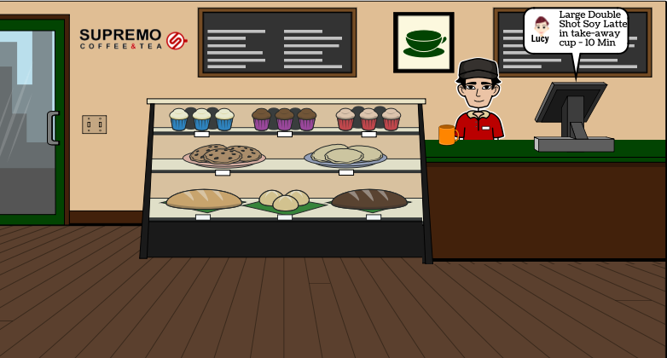

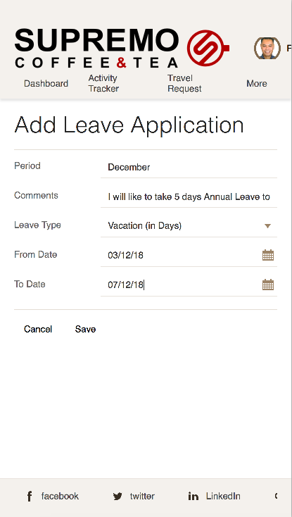

Staff
Kirk is thinking of taking leave to go on vacation
He connects with his mobile phone to the Cafe Supremo HR App
..and submits his leave request… and waits for approval from his manager Robin

Slide 7
HQ-Staff : Manager Persona - ROBIN
Scott:
Uses Managers Dashboard to provide reports to Regional Manager
Approves, travel, expenses, leave, and Timesheets
Visual Builder Cloud:
Provides rich Data Visualization
Out of the box integration with Process Cloud
Build in Business Objects
Utilize external REST Services
Connectors to Oracle SaaS
ROBIN
Manager
Manages store personnel and approvals

Slide 8

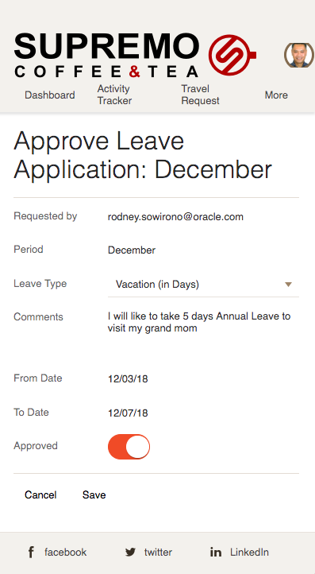
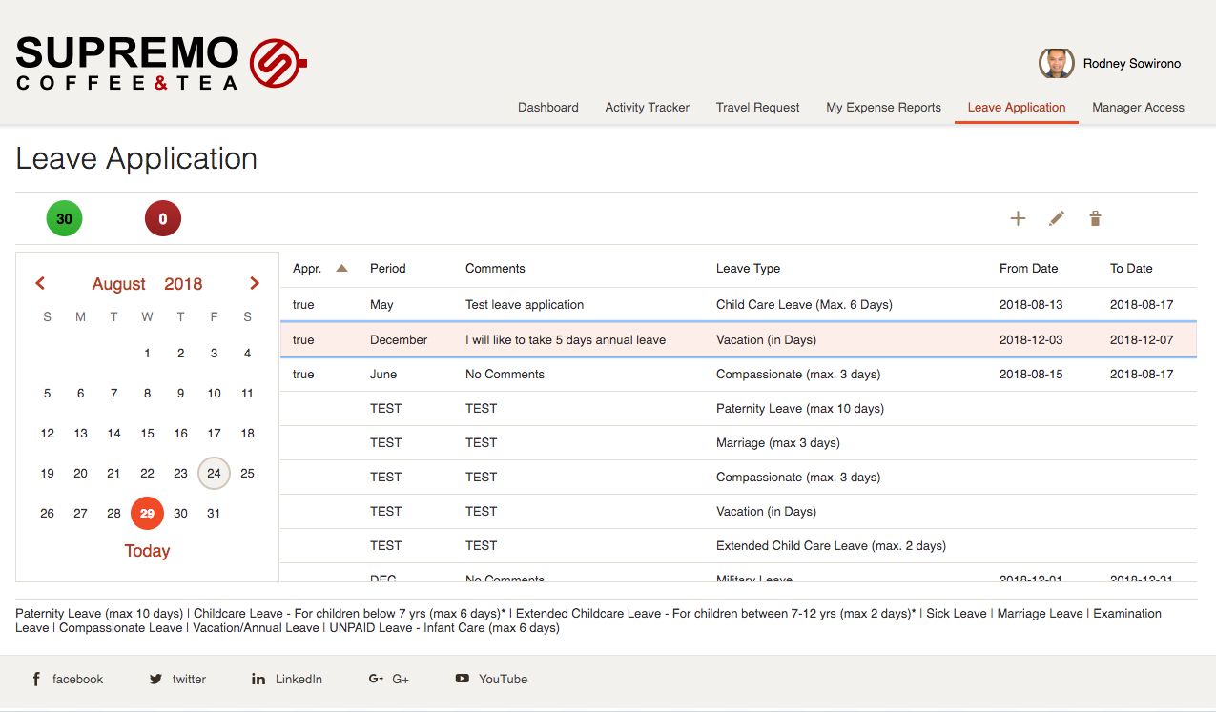




Manager
Once confirmed, He logs in to the HR App and Approves Kirk’s leave request
Robin, the Manager, receives a leave request from Kirk. He collaborates with the team to ensure there is enough personnel to take over Kirk’s tasks
Kirk is notified and can see his leave as approved in the HR app
!
SUBMIT

Slide 9
Creators : Developer Persona - SANDY
Robin uses the low-code, drag-and-drop browser based visual developer tool to design and build reusable web and mobile applications:
Business Objects
Service Data Providers
Data binding for UI Components
Rich Web application UI
Native Mobile Application UI
Versionable Applications via DevCS
Custom Components (CCA)
Chatbot component
Autonomous Visual Builder Cloud:
Visual Page Layout
Visual Page Flow Diagram
Visual Action Definition
Visual REST Connection
Visual Business Object Creation
Visual Business Objects Logic
Directly access code
Add your own logic
Extendable platform
UI Components
JavaScript Libraries
Styles
SANDY
Developer
Develops the Café Supremo HR Application

Slide 10
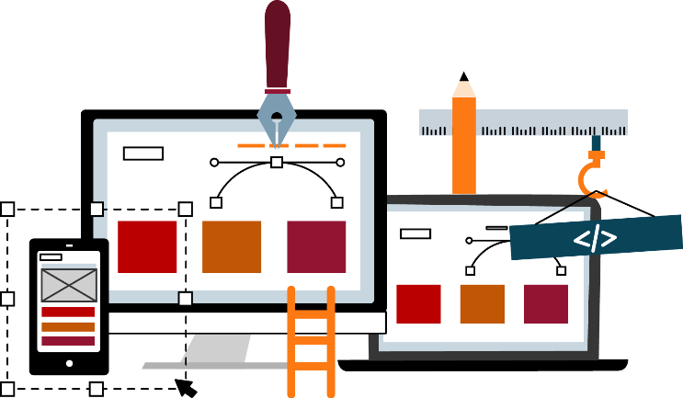


Developer
Sandy, receives new requirements for the HR App and shares it with the development team. They can quickly collaborate using Wiki’s in DevCS, and decide which part needs to be build.
SUBMIT
Sandy builds custom apps with modern DevOps tools, and embed them into the site. After completing her work, Robin Synchronizes it with GitHub repository in DevCS and Publishes the application
Edit, drop and swap components as required.
Sandy uses low code development tool to build the new functionality and adds it in the Café Supremo HR app

